Slide 1
Revenue insights of amigo hardware
File created on: 1/29/2022 7:04:03 PM

Slide 2
Data Analysis Using SQL
Show all customer records
SELECT * FROM customers;
Show total number of customers
SELECT count(*) FROM customers;
Show transactions for Chennai market (market code for chennai is
Mark001
SELECT * FROM transactions where market_code='Mark001';
Show distrinct product codes that were sold in chennai
SELECT distinct product_code FROM transactions where market_code='Mark001';
Show transactions where currency is US dollars
SELECT * from transactions where currency="USD"Show transactions in 2020 join by date

Slide 3
SELECT transactions., date. FROM transactions INNER JOIN date ON transactions.order_date=date.date where date.year=2020;
Show total revenue in year 2020,
SELECT SUM(transactions.sales_amount) FROM transactions INNER JOIN date ON transactions.order_date=date.date where date.year=2020 and transactions.currency="INR\r" or transactions.currency="USD\r";
Show total revenue in year 2020, January Month,
SELECT SUM(transactions.sales_amount) FROM transactions INNER JOIN date ON transactions.order_date=date.date where date.year=2020 and and date.month_name="January" and (transactions.currency="INR\r" or transactions.currency="USD\r");
Show total revenue in year 2020 in Chennai
SELECT SUM(transactions.sales_amount) FROM transactions INNER JOIN date ON transactions.order_date=date.date where date.year=2020 and transactions.market_code="Mark001";

Slide 4


Slide 5


Slide 6
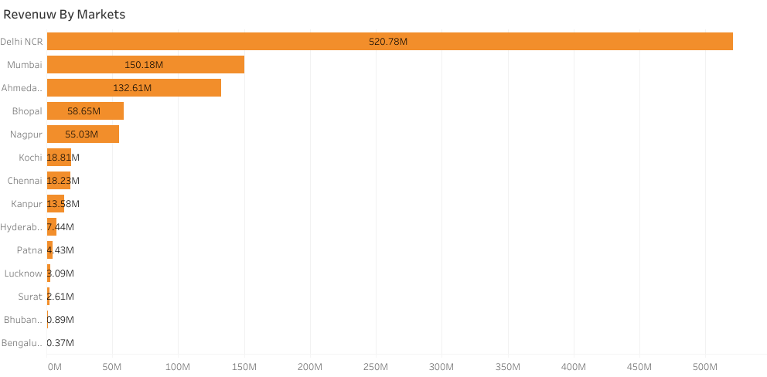

Slide 7
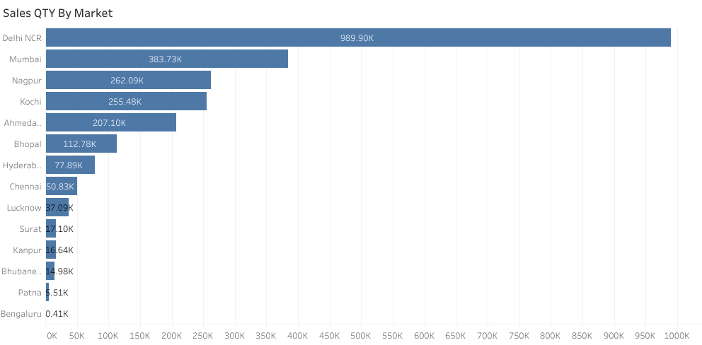

Slide 8
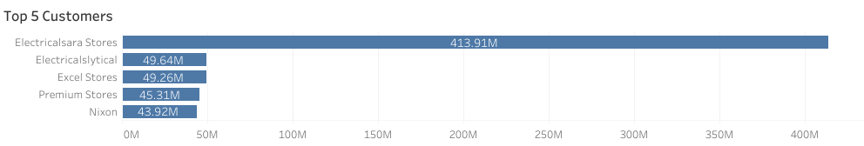

Slide 9
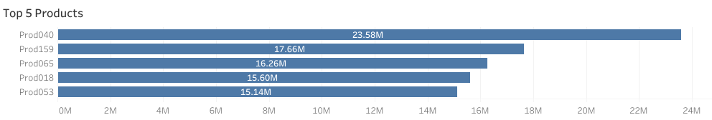

Slide 10
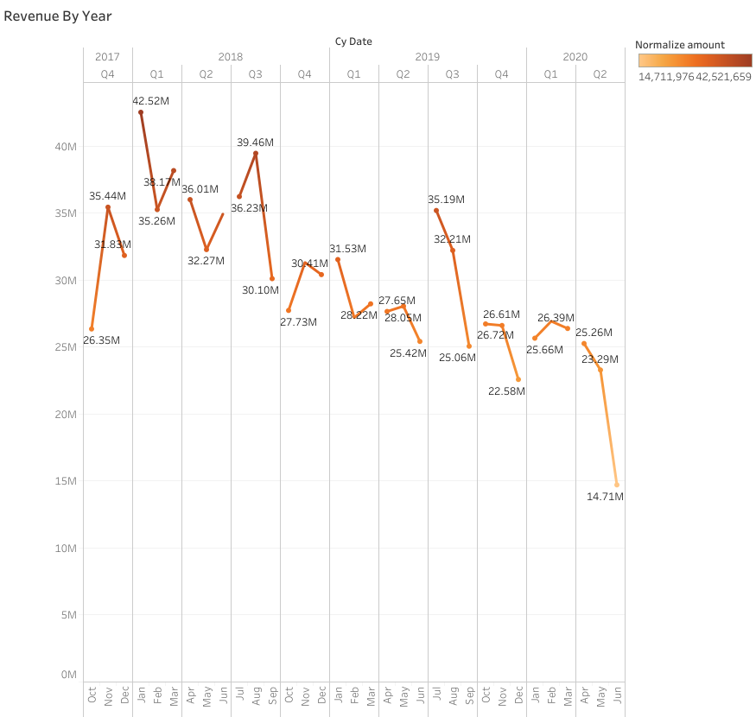

Slide 11


Slide 13
